Slide 1
Mongo Indexes
Rahul
161126

Slide 2
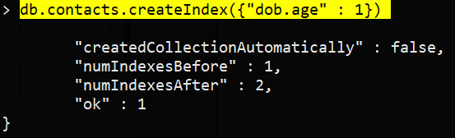
Create Index
db.contacts.createIndex({"dob.age" : 1})

Slide 3
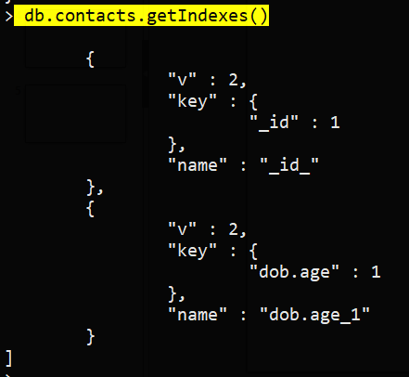
Get Index
db.contacts.getIndexes()

Slide 4

Drop Index
db.contacts.dropIndex({"dob.age":1})

Slide 5
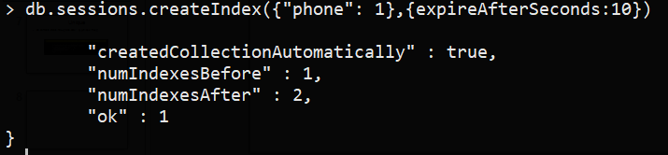
TTL Index
db.sessions.createIndex({createdAt: 1},{expireAfterSeconds:10})

Slide 6
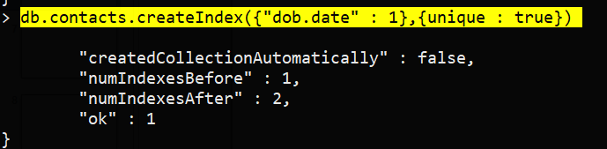
Unique
db.contacts.createIndex({"dob.date" : 1},{unique : true})

Slide 7
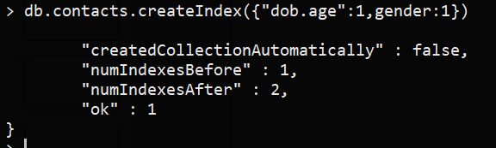
Combination Index
db.contacts.createIndex({"dob.age":1,gender:1})

